Slide 1
Eco LifeStyle Agent
IBM HACKATHON PROJECT
Presented By: Nandini.B
Student name :Nandini.Banothu
College Name & Department : Malla Reddy Engineering College For Women - CSE

Slide 2
OUTLINE
Problem Statement
Technology used
Wow factor
End users
Result
Conclusion
Git-hub Link
Future scope
IBM Certifications

Slide 3
Problem Statement
Eco Lifestyle Agent The Challenge – An Eco Lifestyle Agent, powered by RAG (Retrieval-Augmented Generation), empowers users to adopt a greener lifestyle through personalized, practical suggestions. It retrieves sustainable living tips, eco-friendly product recommendations, local recycling guidelines, and government schemes from trusted environmental sources. Users can ask natural language questions such as “How can I reduce plastic use at home?” or “What are eco-friendly travel options in my city?” and receive instant, actionable guidance. The agent promotes small daily actions with big environmental impact, making sustainability easy and accessible. This AI-driven assistant fosters eco-conscious decisions, raises awareness, and helps build a more sustainable future.
Solution: An Eco Lifestyle Agent powered by Retrieval-Augmented Generation (RAG) delivers personalized, practical green-living guidance by seamlessly pulling from vetted environmental databases, product reviews, local recycling rules, and government sustainability programs. Whether you ask, “How can I cut down on single-use plastics?” or “What’s the most eco-friendly way to commute in my area?”, it instantly curates tailored tips—like swapping plastic wrap for beeswax wraps, finding nearby refill stations, choosing low-emission transport options, or applying for solar subsidies—and presents actionable steps you can implement today. By embedding small, high-impact habits into your daily routine, this AI assistant makes eco-conscious living approachable, empowering you to reduce waste, conserve resources, and contribute to a healthier planet—one simple suggestion at a time.

Slide 4
Technology used
IBM cloud lite services
Natural Language Processing (NLP)
Retrieval Augmented Generation (RAG)
IBM Granite model

Slide 5
IBM cloud services used
IBM Cloud Watsonx AI Studio
IBM Cloud Watsonx AI runtime
IBM Cloud Agent Lab
IBM Granite foundation model

Slide 6
Wow factors
Personalized Sustainability Guidance : Understands your lifestyle and offers tailored eco-friendly tips (e.g., based on your city, habits, or household size).
Smart Information Retrieval : Uses Retrieval-Augmented Generation to pull real-time info from trusted sources—like government sites, eco-blogs, and green product reviews.
Eco-Friendly Product Recommender : Suggests verified sustainable products (e.g., biodegradable cleaning items, reusable containers, low-energy appliances) with purchase links or local store availability.
Local Recycling & Disposal Guidelines : Gives hyper-local information on how to recycle or dispose of items like e-waste, batteries, or plastic wrappers according to your municipality's rules.
Natural Language Understanding : Supports everyday language queries like “What can I do with old clothes?” or “How to compost in an apartment?”

Slide 7
End users
Environment Researchers
Eco-Conscious Individuals
NGO’s
Educators

Slide 8
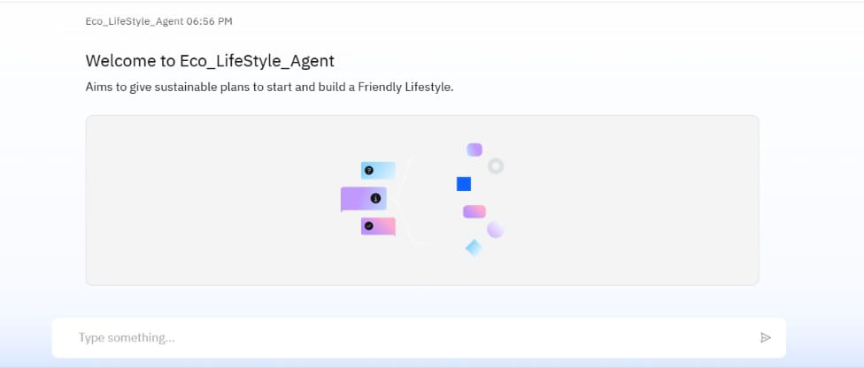
Results

Slide 9
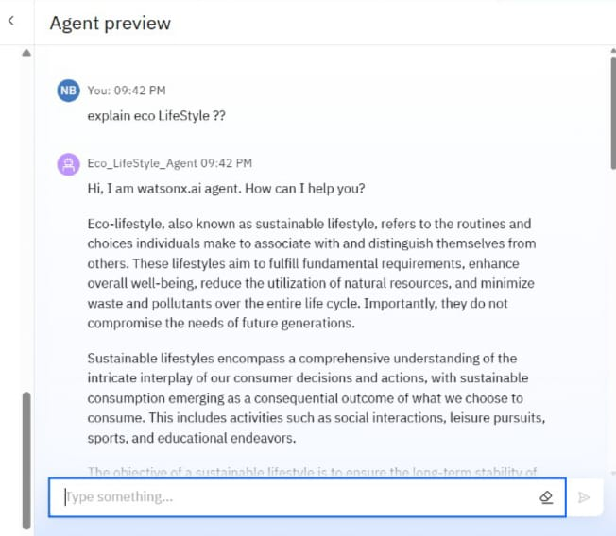
Results

Slide 10
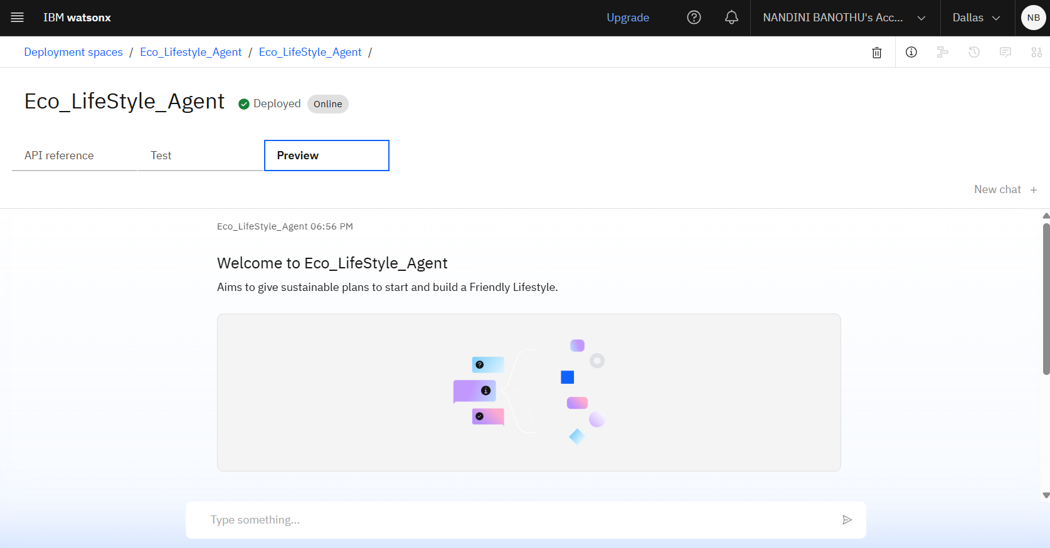
Results
Deployed AI Agent:

Slide 11
Conclusion
Personalized, Actionable Guidance: The Eco Lifestyle Agent provides tailored, easy-to-follow tips and product suggestions to help users seamlessly adopt greener habits in daily life.
Trusted, Localized Information: By using Retrieval-Augmented Generation (RAG), it pulls up-to-date content from reliable sources, including local recycling rules, government schemes, and eco-resources.
Empowering Sustainable Living: It fosters long-term eco-conscious behavior by making sustainability accessible, practical, and impactful for individuals, families, and communities.

Slide 12
GitHub Link
GitHub:https://github.com/Nandini-Banothu1114/Eco_LifeStyle_Agent.git

Slide 13
Integration with Smart Home Devices
Sustainability Analytics Dashboard
Eco-Friendly Marketplace Integration
Mobile App & Wearable Expansion
Multilingual & Voice Assistant Support
Community & Social Features
Future scope

Slide 14
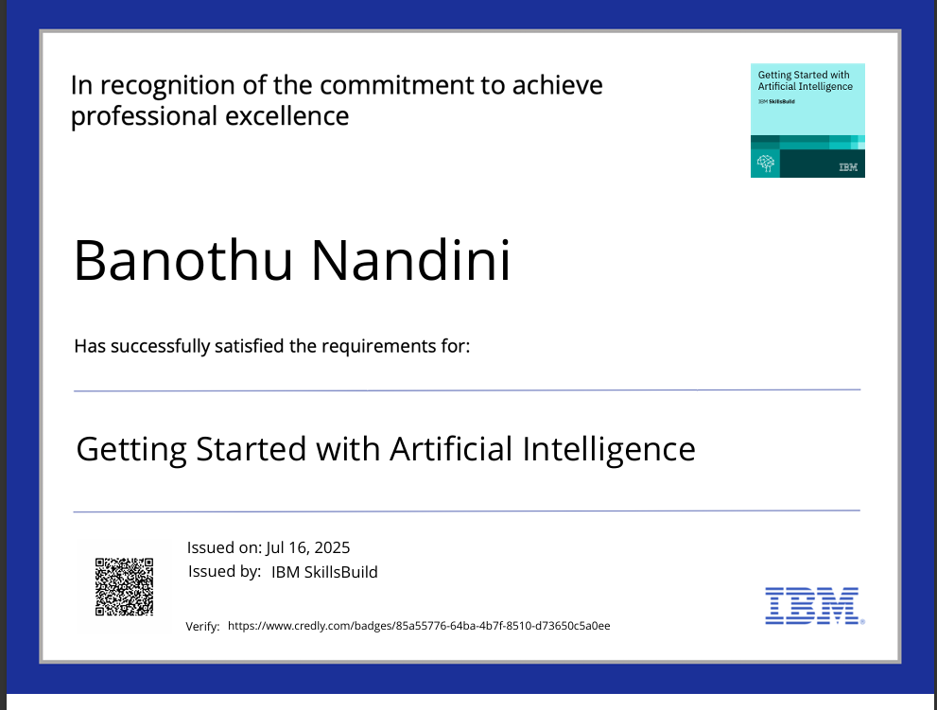
IBM Certifications

Slide 15
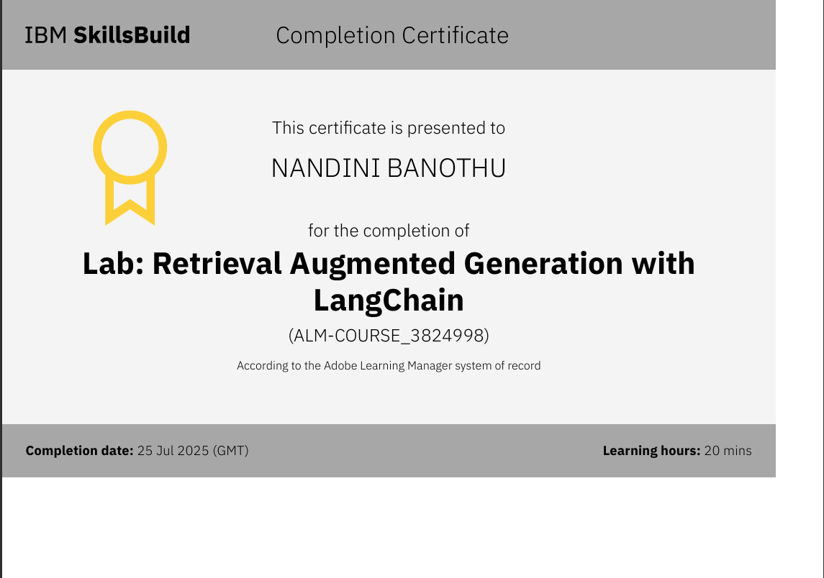

Slide 16
THANK YOU

